Slide 1



“NEVER STOP SERVING”
Legislative Advocacy – Philanthropy & Community Service – Camaraderie

Slide 2
“NEVER STOP SERVING”
General Meeting – 11 Mar 2025
Call to order:
New Members and Guests
Legislative Advocacy – Philanthropy & Community Service – Camaraderie

Slide 3
“NEVER STOP SERVING”
Pledge of Allegiance
"I pledge allegiance to the Flag of the United States of America, and to the Republic for which it stands, one Nation under God, indivisible, with liberty and justice for all."
Legislative Advocacy – Philanthropy & Community Service – Camaraderie

Slide 4
“NEVER STOP SERVING”
Invocation
Jim Mackowski
CDR USN (Ret)
Legislative Advocacy – Philanthropy & Community Service – Camaraderie

Slide 5
“NEVER STOP SERVING”
POW/MIA Moment of Silence
The table is round – to show our everlasting concern.
The tablecloth is white, symbolizing the purity of their motives when answering the call to serve.
The single red rose reminds us of the lives of these Americans…and the loved ones and friends who keep the faith, awaiting answers.
The yellow ribbon symbolizes our continued uncertainy, hope for their return and determination to account for them.
A slice of lemon reminds us of their bitter fate, captured or missing in a foreign land.
A pinch of salt symbolizes the tears of our missing and their families.
The lighted candle reflects our hope for their return.
The glasses are inverted - to symbolize their inability to share a toast. The chair is empty – they are missing.
Legislative Advocacy – Philanthropy & Community Service – Camaraderie

Slide 6
“NEVER STOP SERVING”
Lunch
MOAA is a politically non-partisan organization
Legislative Advocacy – Philanthropy & Community Service – Camaraderie

Slide 7
“NEVER STOP SERVING”
Guest Speaker
Ken Timmerman
Journalist, author, and Middle East expert. Over the past four decades he has interviewed dissidents behind the Iron Curtain, covered numerous Middle East wars, interviewed suicide bombers, and debriefed defectors from Iranian intelligence organizations. He has authored Dark Forces: The Truth About What Happened in Benghazi; The Iran House: Tales of Revolution, Persecution, War, and Intrigue; Countdown to Crisis: The Coming Nuclear Showdown With Iran; ISIS Begins: A Novel of the Iraq War and many more.
Legislative Advocacy – Philanthropy & Community Service – Camaraderie

Slide 8

“NEVER STOP SERVING”
President’s Report
- Nassau County Chapter -
5 Star LOE Award Winner - 2023
LOE awards are MOAA's most prestigious affiliate awards, honoring councils and chapters for their efforts across the full scope of our association's mission.
Legislative Advocacy – Philanthropy & Community Service – Camaraderie

Slide 9
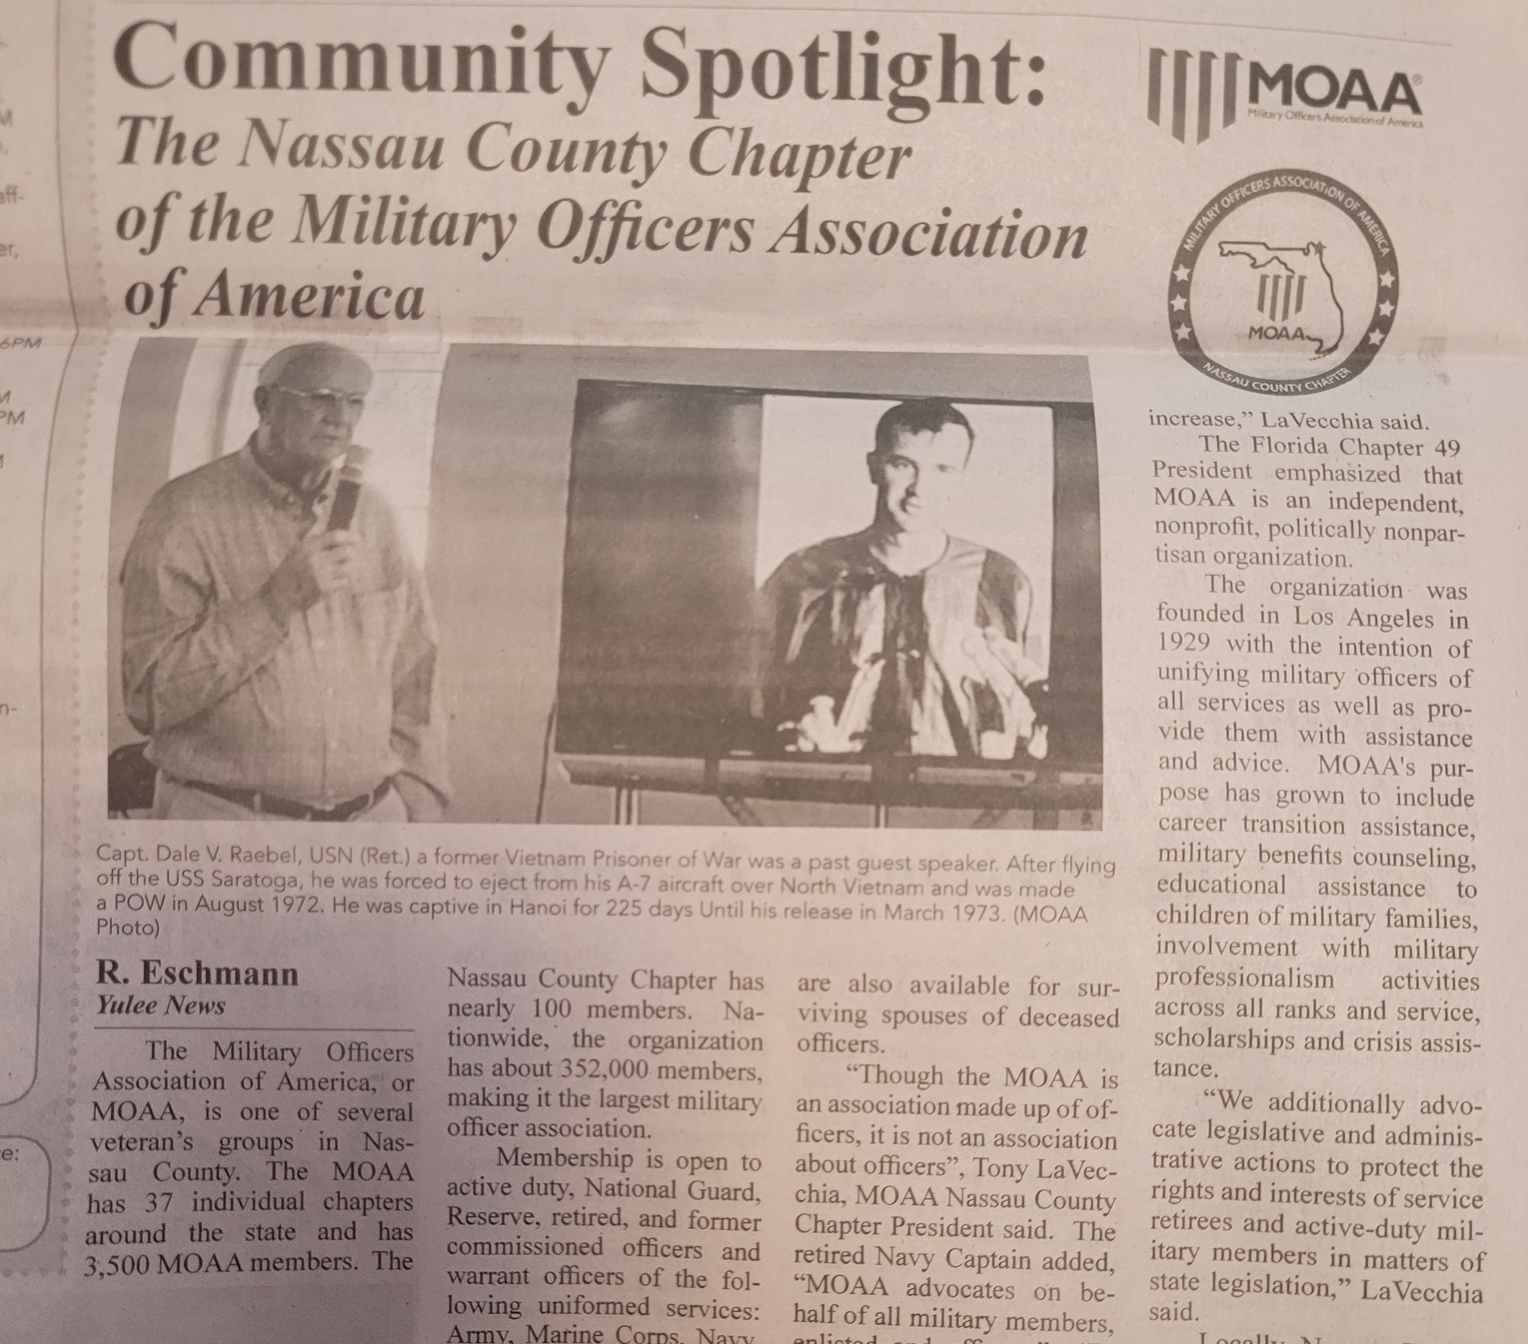
“NEVER STOP SERVING”
President’s Report
C & H News
Buzz Around Town
20 Feb 2025
Legislative Advocacy – Philanthropy & Community Service – Camaraderie

Slide 10
“NEVER STOP SERVING”
Chapter Plan
Lines of Effort
Objectives
Outcomes
Advocacy
Philanthropy &
Community Service
Camaraderie
LOE #1
JROTC Scholarship
The MOAA Foundation (TMF)
Memorial Day Services
Veterans Day Parade
More Members Enrolled
In the LAC, More Members for
Philanthropic Activities,
Overall Greater Camaraderie
Membership
Legislative Action
Center (LAC)
Call to Action
Congressional
Representative
Visits
Monthly Meetings
Officer Call
Memorial Day
Services
Veterans Day
Parade
Holiday Party
FCoC Convention
LOE #2
Higher % in Calls to Action, More Members Donating to TMF, Greater Attendance at MOAA Events
Participation
LOE #3
Larger and Multi Year Scholarship Distributions, Less Expensive or Free Chapter Events
Fundraising
Legislative Advocacy – Philanthropy & Community Service – Camaraderie

Slide 11
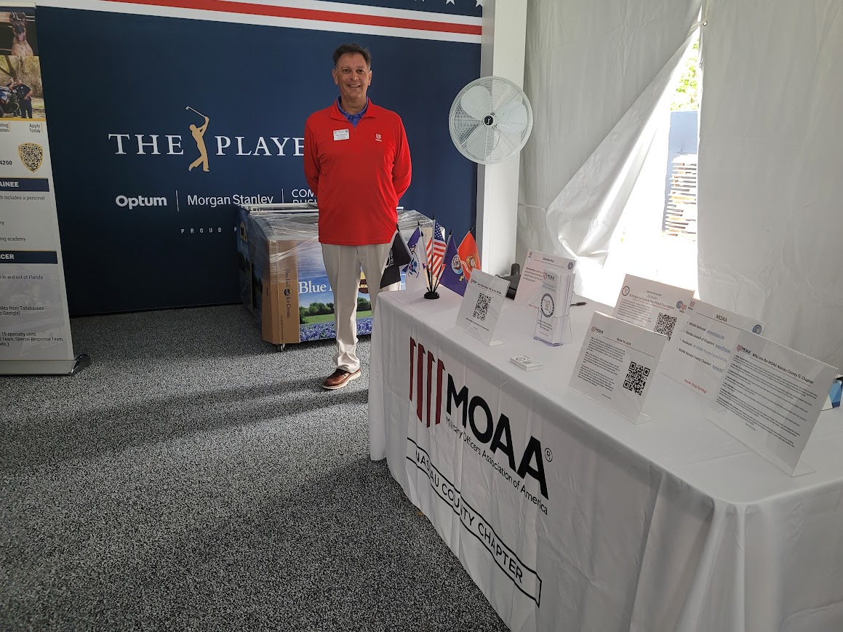
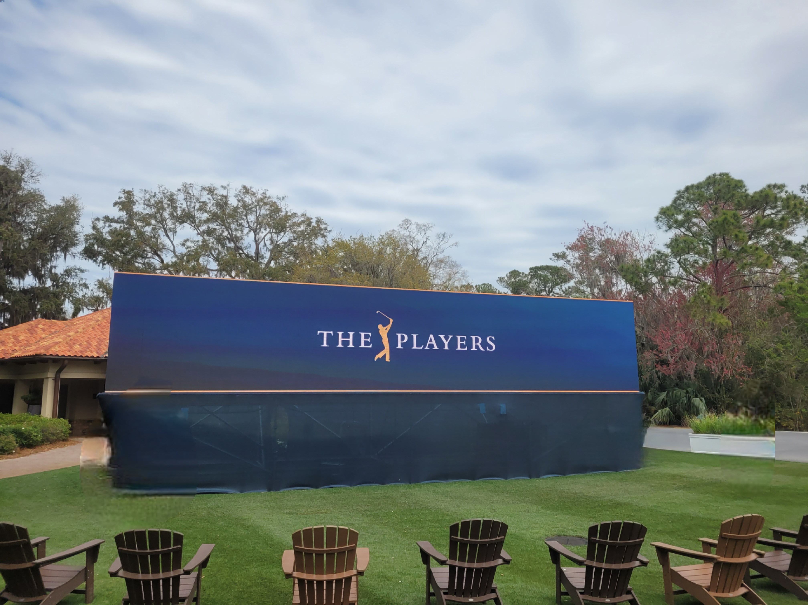
“NEVER STOP SERVING”
Mission Area Update
- Advocacy -
Call to Action Email – February
(LOE #2 Participation)
Recruitment Event – TPC/Sawgrass, 8 March
(LOE #1 Membership, LOE #2 Participation, LOE #3 Fundraising)
Legislative Advocacy – Philanthropy & Community Service – Camaraderie

Slide 12
“NEVER STOP SERVING”
Mission Area Update
- Philanthropy & Community Service -
$5,000 MOAA Community Outreach Grant Requested
Support Junior Enlisted at Kings Bay with commissary gift cards
More to follow
(LOE #3 – Fundraising)
Donation Drive Dates - 14 June and 2 December
More to follow
(LOE #3 Fundraising, LOE #1 Membership, LOE #2 Participation)
Legislative Advocacy – Philanthropy & Community Service – Camaraderie

Slide 13
“NEVER STOP SERVING”
Mission Area Update
- Camaraderie -
Officer Call Held 13 February – Gators Dockside
(LOE #2 – Participation)
Monthly Chapter Membership Meetings – Guest Speakers
(LOE #2 Participation)
Legislative Advocacy – Philanthropy & Community Service – Camaraderie

Slide 14
“NEVER STOP SERVING”
1st Vice President’s Report
Jeff Carr, COL USA (Ret)
November Chapter Meeting Rescheduled – NEW Date: 18 Nov
Meeting Time – 1130, same as original time
Original meeting date was 11 Nov, Veterans Day
Legislative Advocacy – Philanthropy & Community Service – Camaraderie

Slide 15
“NEVER STOP SERVING”
2nd Vice President’s Report
Dwight Collins
CAPT USCG (Ret)
Legislative Advocacy – Philanthropy & Community Service – Camaraderie

Slide 16
“NEVER STOP SERVING”
Treasurer’s Report
Bob Bell, CAPT USN (Ret)
Account reconciled with the bank statement
Received $501 in Donations through Zeffy
Donated $100 for the Traveling Vietnam Memorial Wall
New Name Tags Available for Pick Up - $15
Legislative Advocacy – Philanthropy & Community Service – Camaraderie

Slide 17
“NEVER STOP SERVING”
Secretary’s Report
Lou Tonti
CDR USN (Ret)
Legislative Advocacy – Philanthropy & Community Service – Camaraderie

Slide 18
“NEVER STOP SERVING”
Legislative Affairs
MOAA Legislative Priorities
Military housing: Recent reporting from the GAO reveals the myriad challenges servicemembers in unaccompanied housing are facing. The health, safety, and privacy concerns outlined by GAO show the need for action.
Toxic exposure: MOAA will focus on capitalizing on our recently released report, Ending the Wait for Toxic-Exposed Veterans, to advocate for veterans exposed to toxic materials during their service.
Spouse employment: Rates of unemployment for military spouses continue to be four to five times higher than the national average. This persistent challenge requires not only providing education and employment resources for spouses, but also incentivizing businesses to hire someone who will likely move in two to three years.
Legislative Advocacy – Philanthropy & Community Service – Camaraderie

Slide 19
“NEVER STOP SERVING”
Legislative Affairs
MOAA Legislative Priorities
Access to care: DoD has acknowledged that congressionally directed reforms to the Military Health System (MHS), together with U.S. medical workforce volatility, exacerbated long-standing access challenges and led to a destabilized MHS that does not consistently deliver timely care to beneficiaries.
Support for caregivers: MOAA has long advocated for legislation that would improve caregiving support for veterans’ families. This includes enhancements to the VA Program of Comprehensive Assistance for Family Caregivers (PCAFC) and expansion of home health and long-term care services to meet current and future needs of veterans, their caregivers, and families.
Legislative Advocacy – Philanthropy & Community Service – Camaraderie

Slide 20
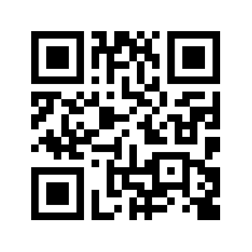
“NEVER STOP SERVING”
Legislative Affairs
Mike McClane, CW4 USA (Ret)
Legislative Action Center (LAC):
Register/Sign Up
Respond to Calls to Action
https://moaa.quorum.us/home2/
Legislative Advocacy – Philanthropy & Community Service – Camaraderie

Slide 21
“NEVER STOP SERVING”
Membership
Charlie Finnigan
Lt. Col. USAF (Ret)
Legislative Advocacy – Philanthropy & Community Service – Camaraderie

Slide 22
“NEVER STOP SERVING”
Data Processing
Dave Kriete
VADM USN (Ret)
Legislative Advocacy – Philanthropy & Community Service – Camaraderie

Slide 23
“NEVER STOP SERVING”
Surviving Spouse Liaison
Mary Gustafson, CAPT USPHS (Ret)
Spouses: Save the Date
May 13 luncheon meeting
Guest speaker: Pat Green, a surviving spouse
President, MOAA’s Surviving Spouse Virtual Chapter
Member, MOAA’s Surviving Spouse Advisory Council
Important Information to Know When the Time Comes
Legislative Advocacy – Philanthropy & Community Service – Camaraderie

Slide 24
“NEVER STOP SERVING”
Fundraising
Vacant
7 Jun: Donation Drive, Publix in Yulee 1100-1600
14 Jun: Spring Donation Target Day
Legislative Advocacy – Philanthropy & Community Service – Camaraderie

Slide 25
“NEVER STOP SERVING”
Programs
Vacant
Legislative Advocacy – Philanthropy & Community Service – Camaraderie

Slide 26
“NEVER STOP SERVING”
JROTC
Gene Kilcawley, LTC USA (Ret)
JROTC Awards Dinner, 10 May
Scholarship - Yulee HS
Legislative Advocacy – Philanthropy & Community Service – Camaraderie

Slide 27
“NEVER STOP SERVING”
Website / Public Affairs
Dr. Tracy Connors
CAPT USN (Ret)
Reviewed and updated web site with current information, e.g., programs, legislative action, images.
Added new pages and posts reflecting expanded coverage of programs and legislative action.
Legislative Advocacy – Philanthropy & Community Service – Camaraderie

Slide 28
“NEVER STOP SERVING”
Newsletter
Rich Sharp
CDR USN (Ret)
Legislative Advocacy – Philanthropy & Community Service – Camaraderie

Slide 29
“NEVER STOP SERVING”
Chaplain
Jim Mackowski
CDR USN (Ret)
Legislative Advocacy – Philanthropy & Community Service – Camaraderie

Slide 30
“NEVER STOP SERVING”
Upcoming Events
7-10 Apr: Advocacy-in-Action (AiA) Campaign, Washington DC
8 Apr: Chapter Meeting – 1130, Guest Speaker: Bill Leeper, Sheriff – Nassau County
17-21 Apr: Traveling Vietnam War Memorial – NEFL Fairgrounds, Callahan FL
xx Apr: Officer Call – On Island, TBD, 1730
10 May: JROTC Awards Dinner
13 May: Chapter Meeting – 1130, Guest Speaker: Pat Green – MOAA Surviving Spouse Board Mbr
26 May: Memorial Day Ceremony at Veterans Memorial Park
7 Jun: Donation Drive – 1100-1600, Publix in Yulee (Chester Rd)
10 Jun: Chapter Meeting – 1730, Guest Speaker: Kevin Lilly, Property Appraiser - Nassau County
xx Jun: Officer Call – Off Island, 1730
Legislative Advocacy – Philanthropy & Community Service – Camaraderie

Slide 31
“NEVER STOP SERVING”
Q & A
Saved Rounds / Questions / Comments
Legislative Advocacy – Philanthropy & Community Service – Camaraderie

Slide 32
“NEVER STOP SERVING”
General Meeting – 11 Mar 2025
Be a Recruiter – Get one person to join our Chapter
Participate – Call to Action / Donate / Attend MOAA Events
Adjourned
50-50
Legislative Advocacy – Philanthropy & Community Service – Camaraderie

